Slide 1

Module 1
Introduction
Notes:
Guidelines
Use section headers to chunk content in your presentation.
Use the same style of section header throughout your presentation.
Keep your title to no more than 2 lines.

Slide 2

Introduction
Notes:
Guidelines
Use a title slide at the beginning of your presentation. There are 9 variations of title slides to choose from.
If you will have a series of slideshows, we recommend using the same style of title slide for each presentation.
Keep your title to no more than 2 lines.
Do not change the font style or font size of the title or subtitle.

Slide 3
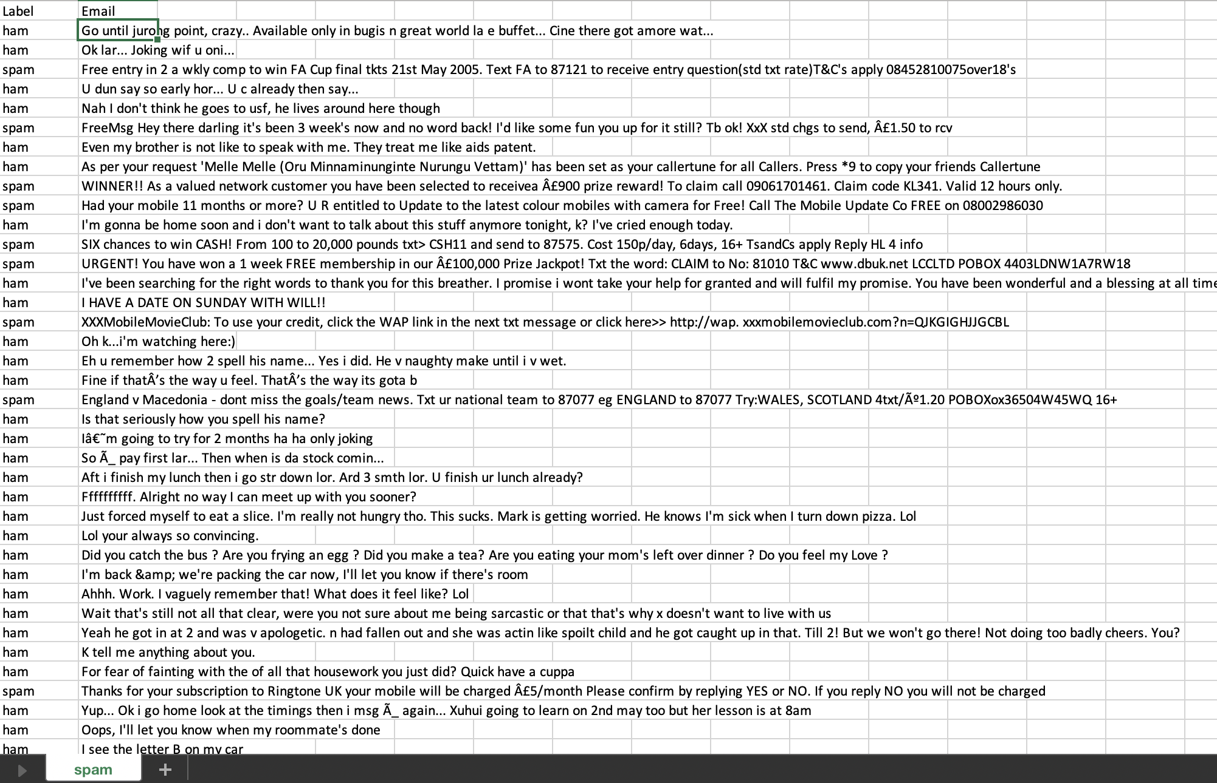



What is Machine Learning?
the field of study that gives computers the ability to learn without being explicitly programmed (Arthur Samuel, 1959).
Pred. Spam
Pred. Ham
Spam
Ham

Slide 4
What is Machine Learning?
A computer program is said to learn from experience E with respect to some task T and some performance measure P, if its performance on T, as measured by P, improves with experience E (Tom Mitchell, 1997).
Pred. Spam
Pred. Ham
Spam
Ham

Slide 5
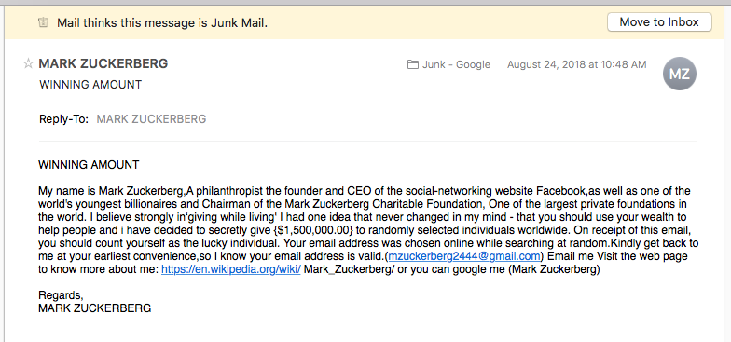
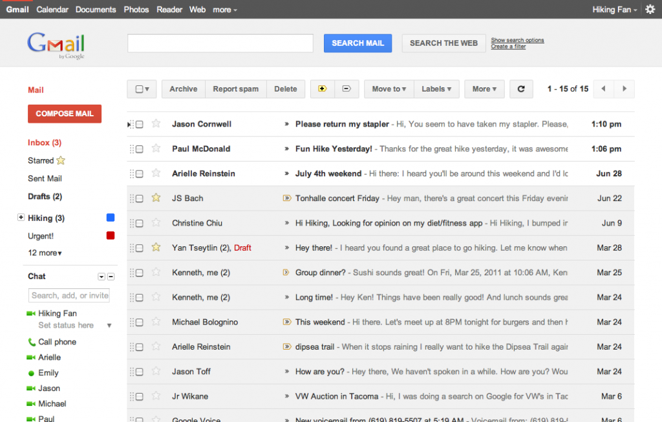
Task
Automatically classify an email as Spam (Bad) or Ham (Good)

Slide 6
Experience
a dataset with emails labeled Spam (Bad), Ham (Good)

Slide 7
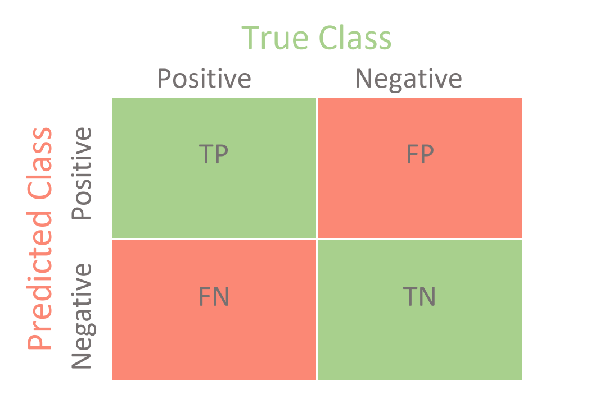
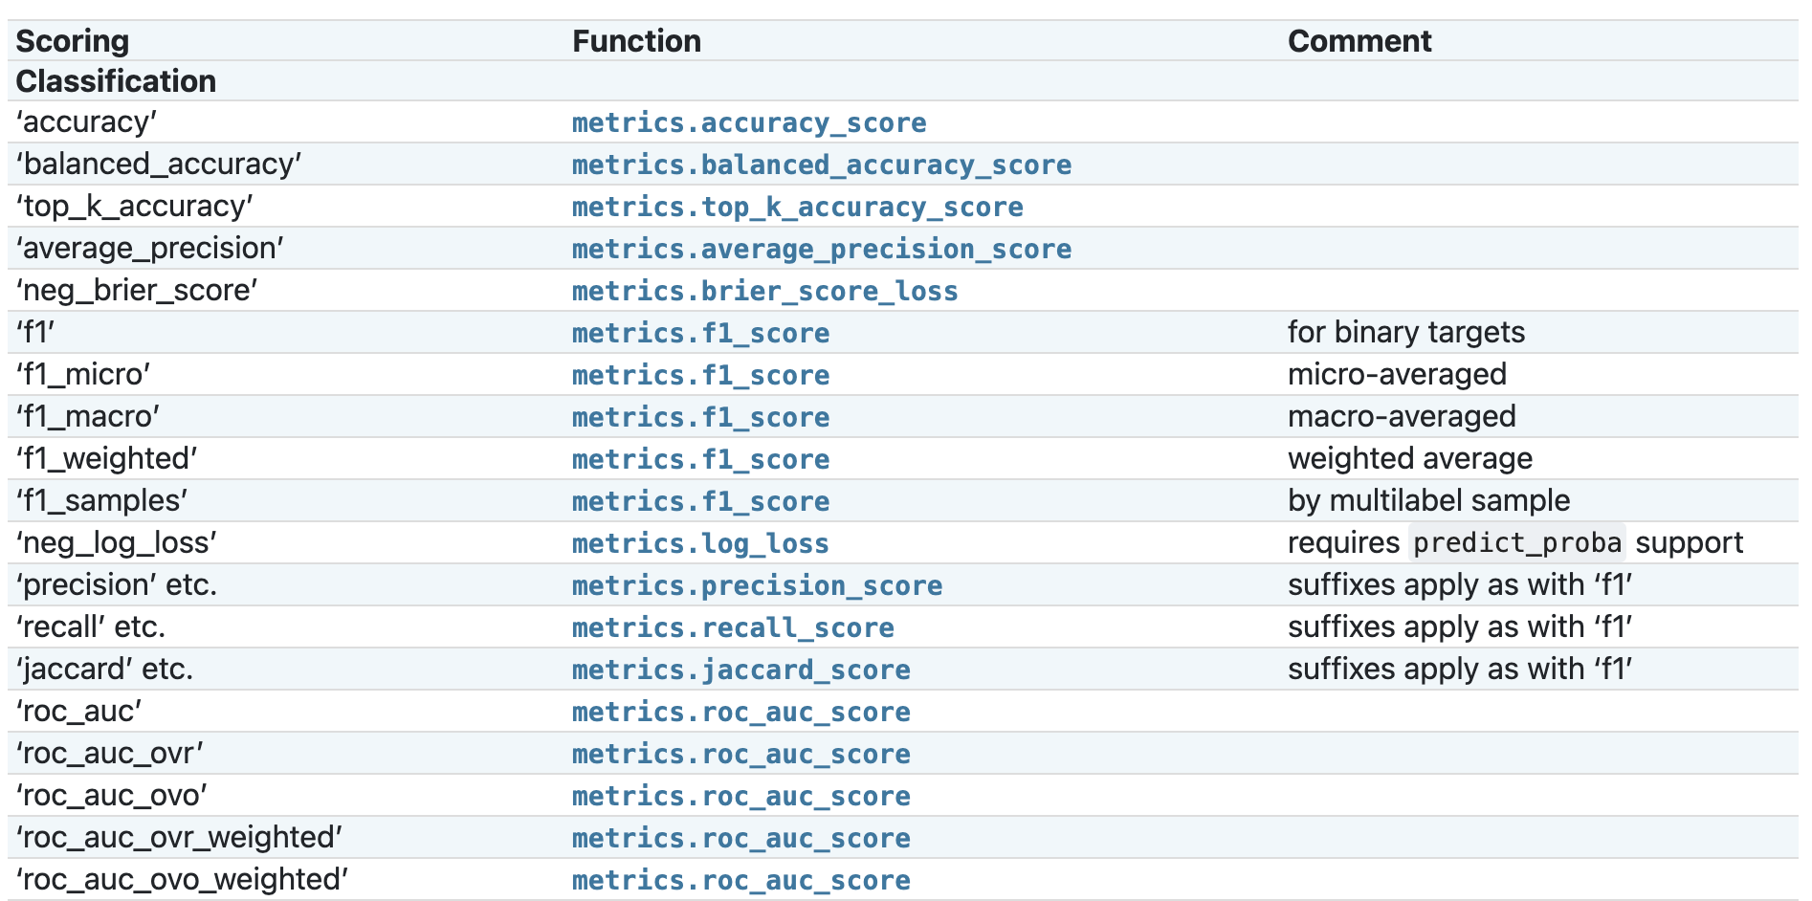
Performance Metrics
a dataset with emails labeled Spam (Bad), Ham (Good)
Scikit-Learn Classification Metrics

Slide 8
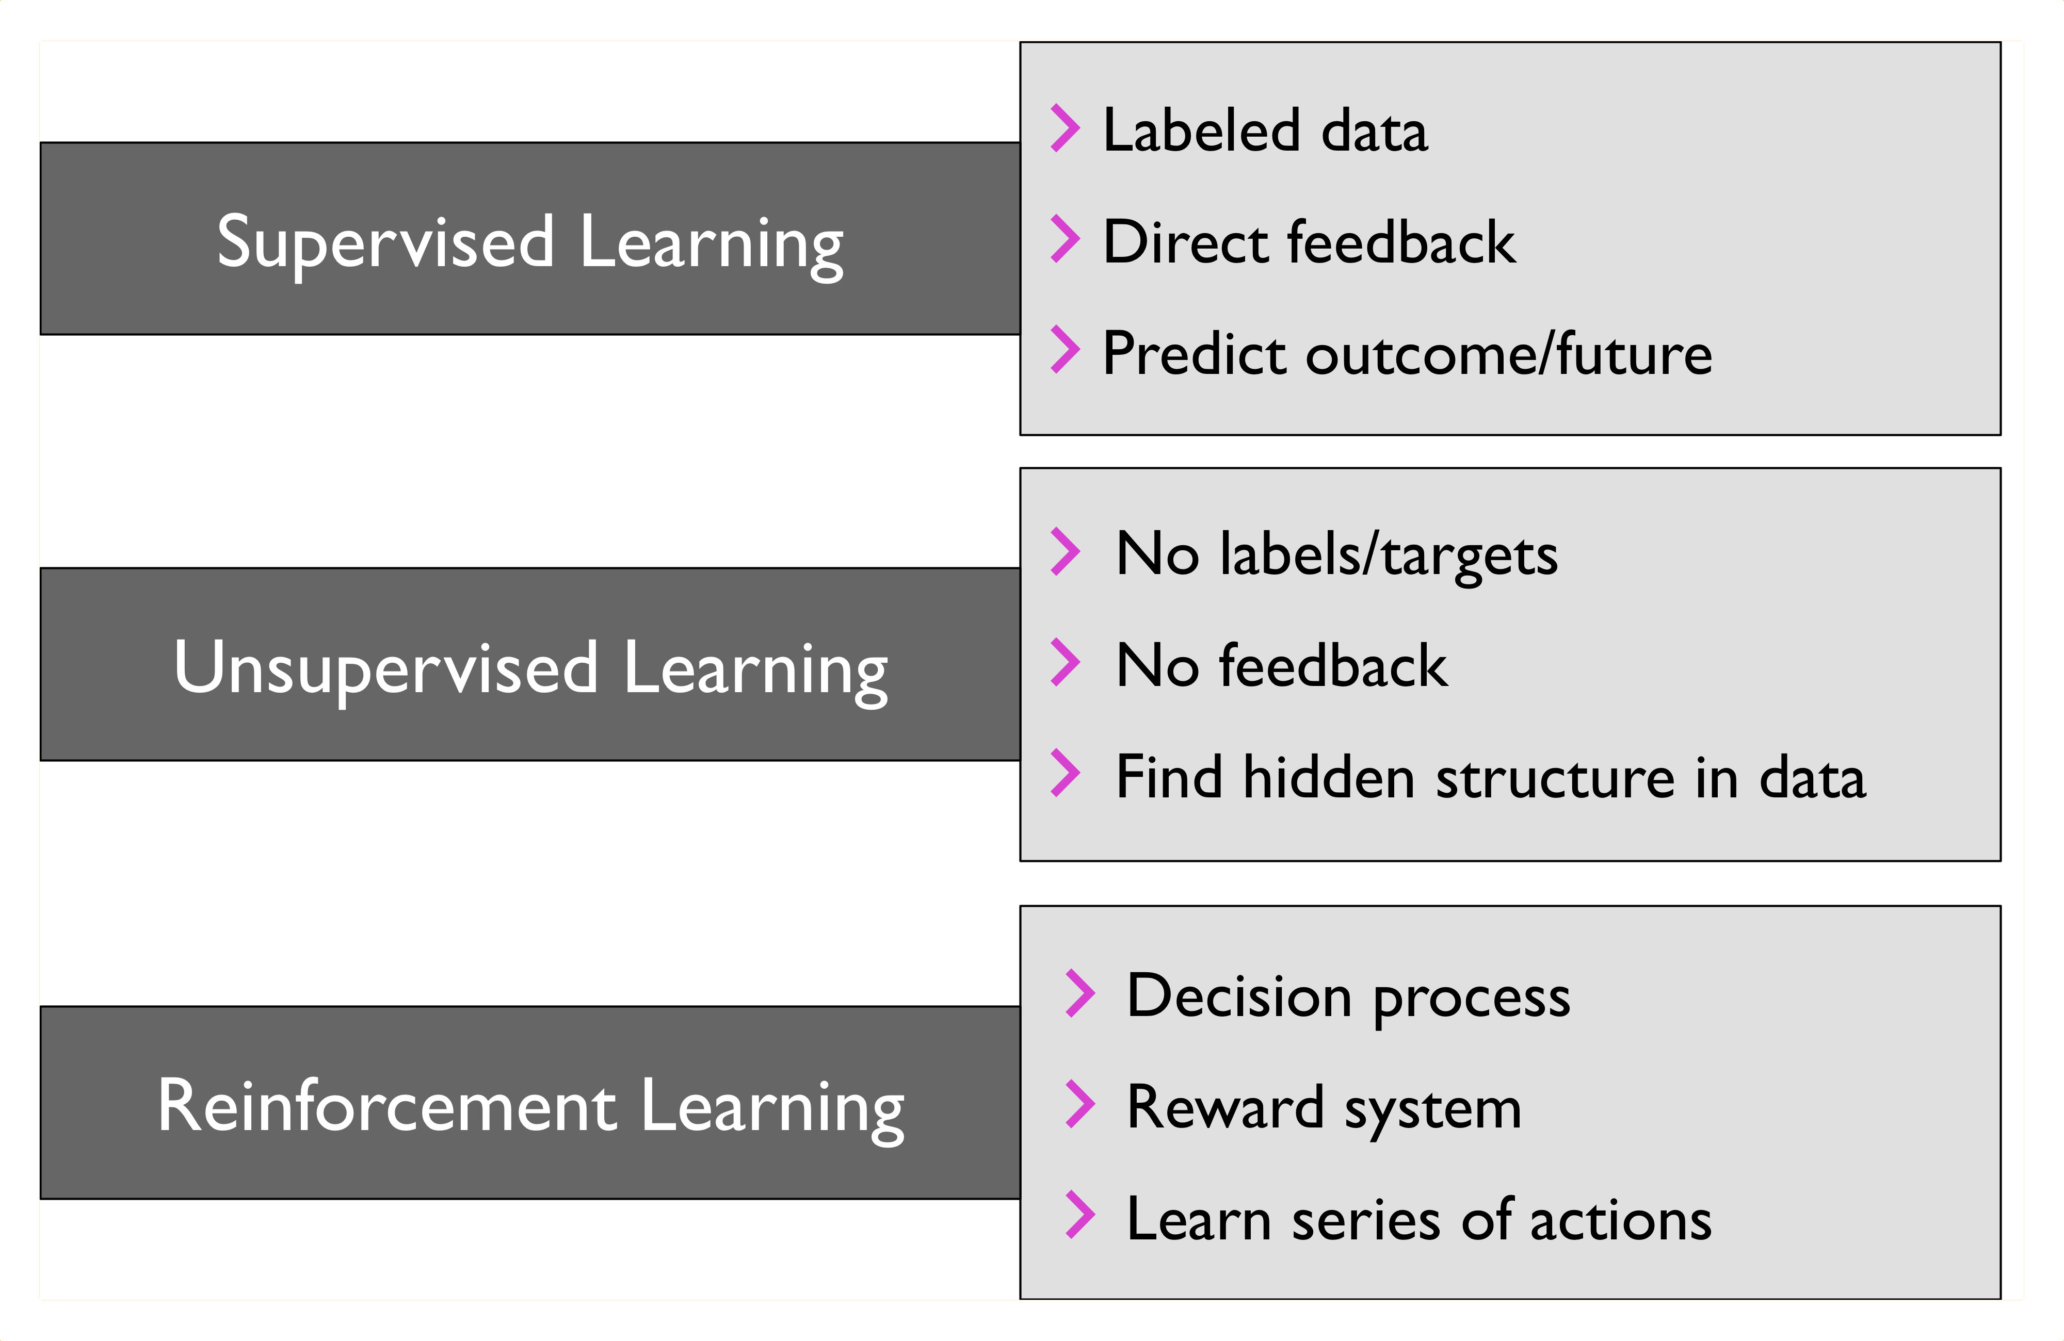
Types of ML Tasks

Slide 9
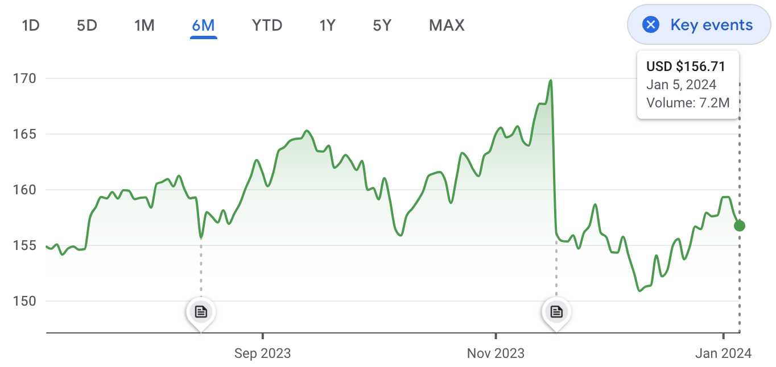
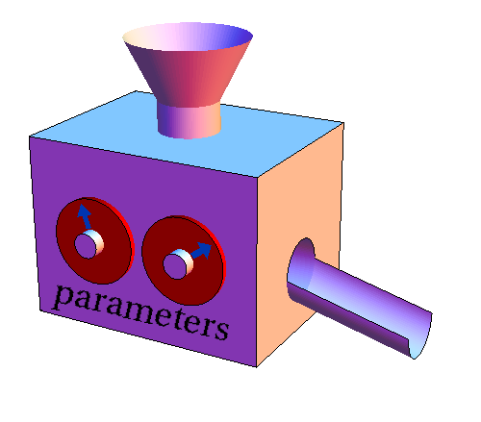
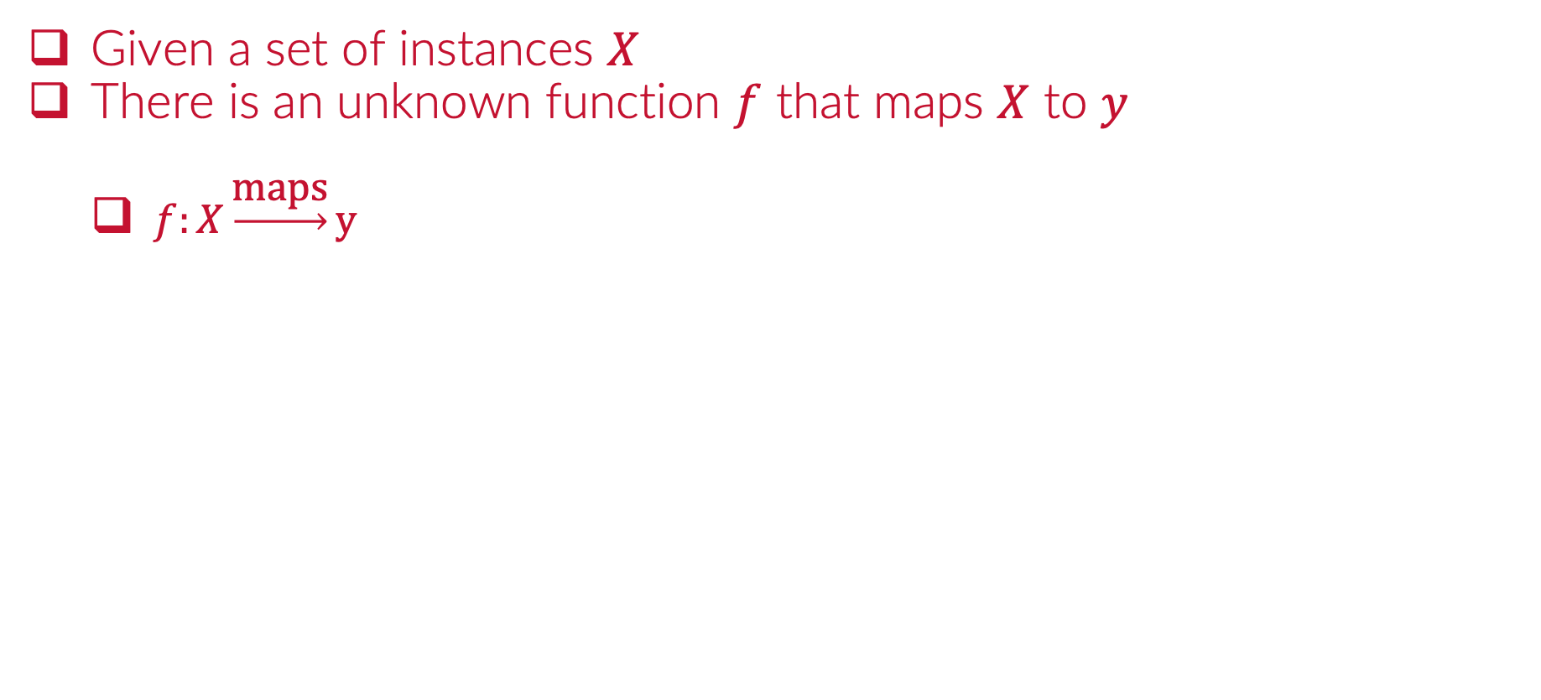
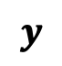

Supervised Learning
Given a set of instances $X$
There is an unknown function $f$ that maps $X$ to $y$
$f:X\underset{→}{\text{maps}}y$
$$X$$
$$y$$

Slide 10
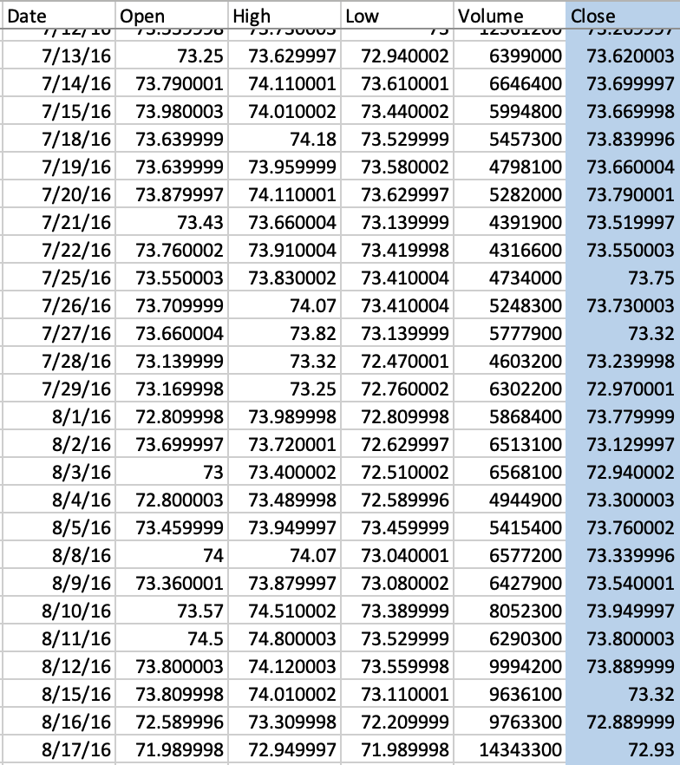
Supervised Learning
Given a set of instances $X$
There is an unknown function $f$ that maps $X$ to $y$
$f:X\underset{→}{\text{maps}}y$
$$X$$
$$y$$

Slide 11
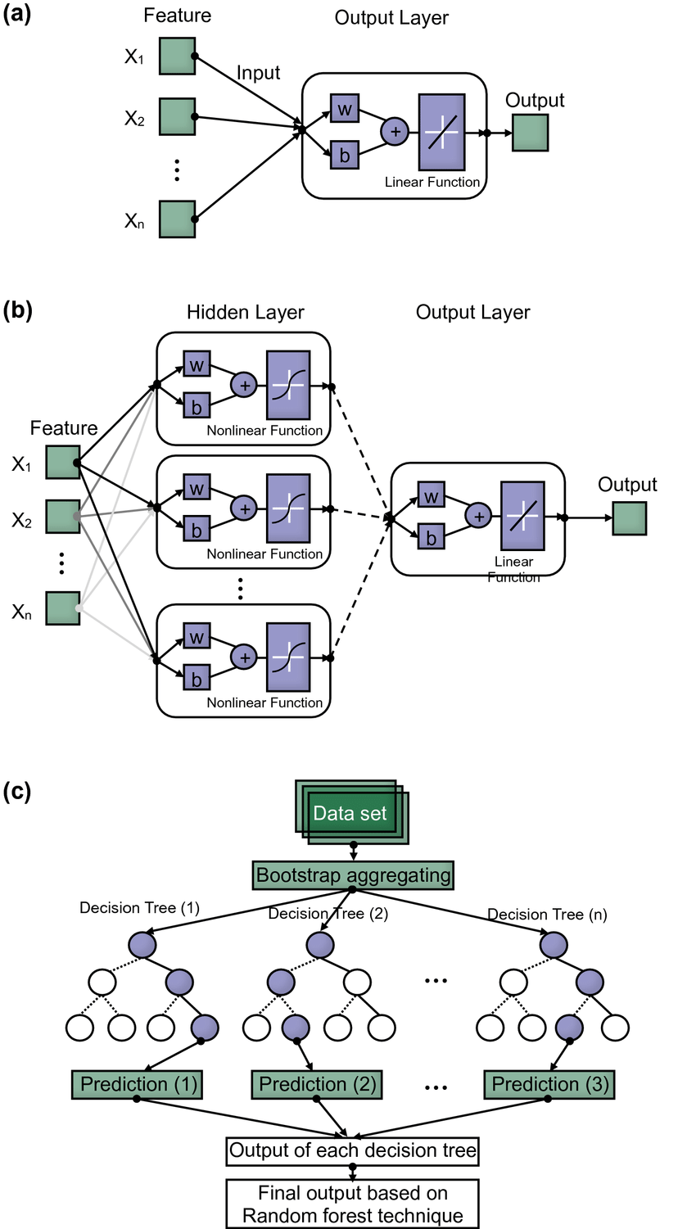
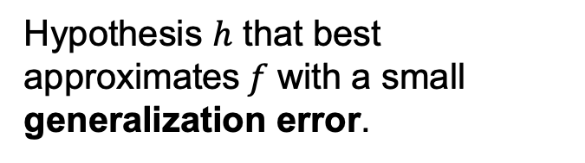
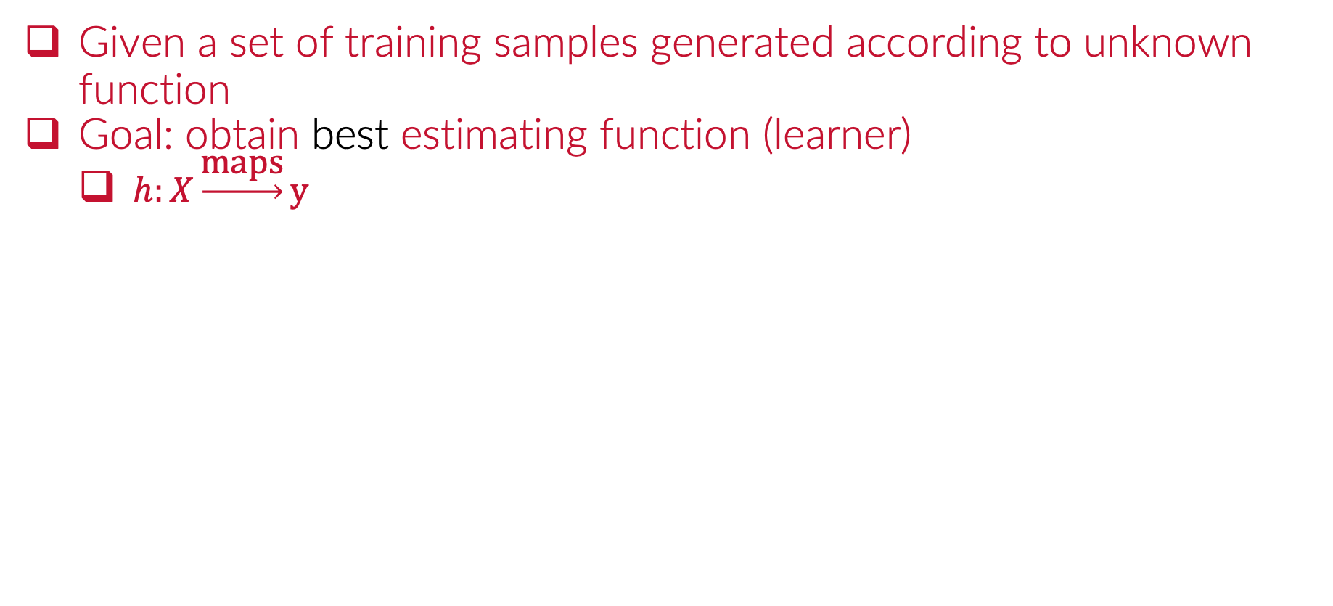
Supervised Learning
Given a set of training samples generated according to unknown function
Goal: obtain best estimating function (learner)
$h:X\underset{→}{\text{maps}}y$
$$X$$
Hypothesis $h$ that best approximates$f$with a small generalization error.
$$y$$
$$R\left[h\right]=E_{XY}g\left(y,h\left(x\right)\right)$$

Slide 12
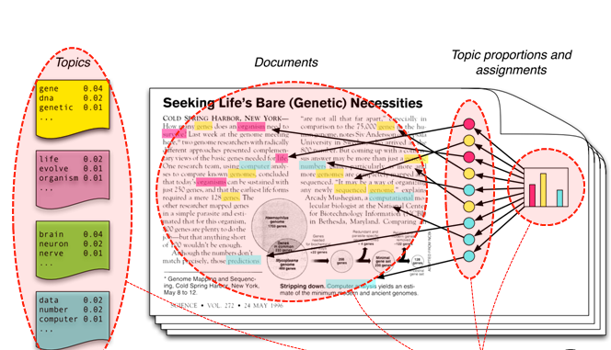
Unsupervised Learning
Given a set of instances
Group instances according to how similar they are

Slide 13
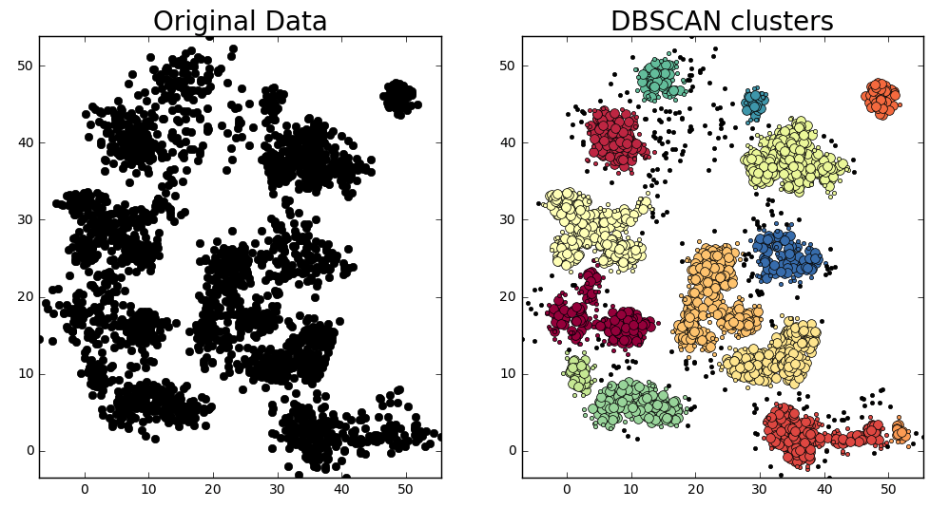
Unsupervised Learning
Given a set of instances
Group instances according to how similar they are

Slide 14
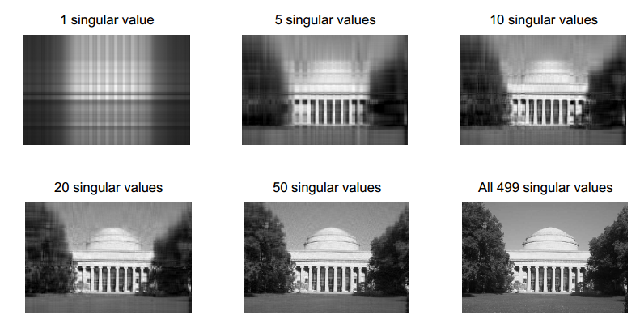
Unsupervised Learning
Given a set of instances
Group instances according to how similar they are

Slide 15

Reinforcement Learning
Model has to learn how to interact with its environment
Learn what to do

Slide 16
Module 0
Introduction
Notes:
Guidelines
Use section headers to chunk content in your presentation.
Use the same style of section header throughout your presentation.
Keep your title to no more than 2 lines.

